Slide 1
The Potential Role of Alternative Transcript Isoforms in Developmental Gene Expressions in Ants
Koray KASAN¹, Ab. Matteen Rafiqi²
¹Bezmialem Vakif University, Faculty of Medicine, Istanbul, Turkey.
²Bezmialem Vakif University, Beykoz Life Sciences and Biotechnology Institute, Molecular Biology Department, Istanbul, Turkey.
Notes:
-Opening speech
--Welcome
--Who i am
--The team
--The headline

Slide 2
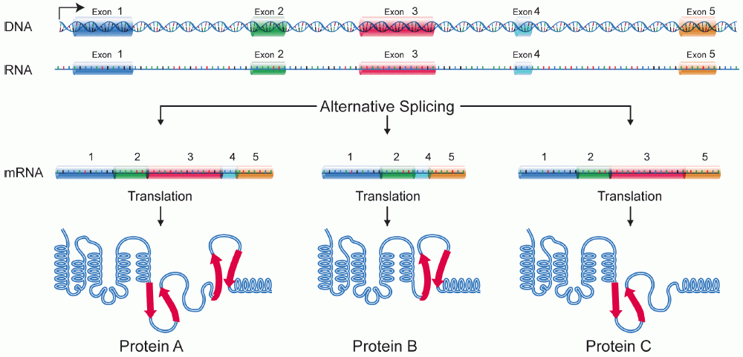
Alternative Transcript Isoforms
The Potential Role of Alternative Transcript Isoforms in Developmental Gene Expressions in Ants
Alternative transcript isoforms can differ in their translated and/or untranslated regions (UTRs).
Changes in the translated regions affect the protein outcome.
Changes in the UTRs affect the stability, subcellular localization and the timing of the translation of the involved transcripts.
Shabalina, S. A., et al. “Evolution at Protein Ends: Major Contribution of Alternative Transcription Initiation and Termination to the Transcriptome and Proteome Diversity in Mammals.” Nucleic Acids Research, vol. 42, no. 11, Mar. 2014, pp. 7132–7144., doi:10.1093/nar/gku342.
11) Chen, Lu, et al. “Alternative Splicing: A Potential Source of Functional Innovation in the Eukaryotic Genome.” International Journal of Evolutionary Biology, vol. 2012, 2012, pp. 1–10., doi:10.1155/2012/596274.
https://en.wikipedia.org/wiki/Protein_isoform#/media/File:DNA_alternative_splicing.gif
Notes:
Alternative transcript isoforms are, simply put, different mRNAs produced from a single gene. The differences in these mrnas or transcript isoforms can be in protein coding sequences resulting in the generation of different protein isoforms, therefore might have functional consequences. And the differences can be in the untranslated regions of mRNAs which affect the posttrancriptional regulation such as…
As you can imagine, changes in the protein coding seqs can have direct functional effects whereas changes in the UTRs can affect the posttranscriptional regulation (such as the…)
Removed: UTRs are involved in the post-transcriptional regulation of spatiotemporal expressions of genes in a cell, tissue or a developmental stage specific manner.

Slide 3
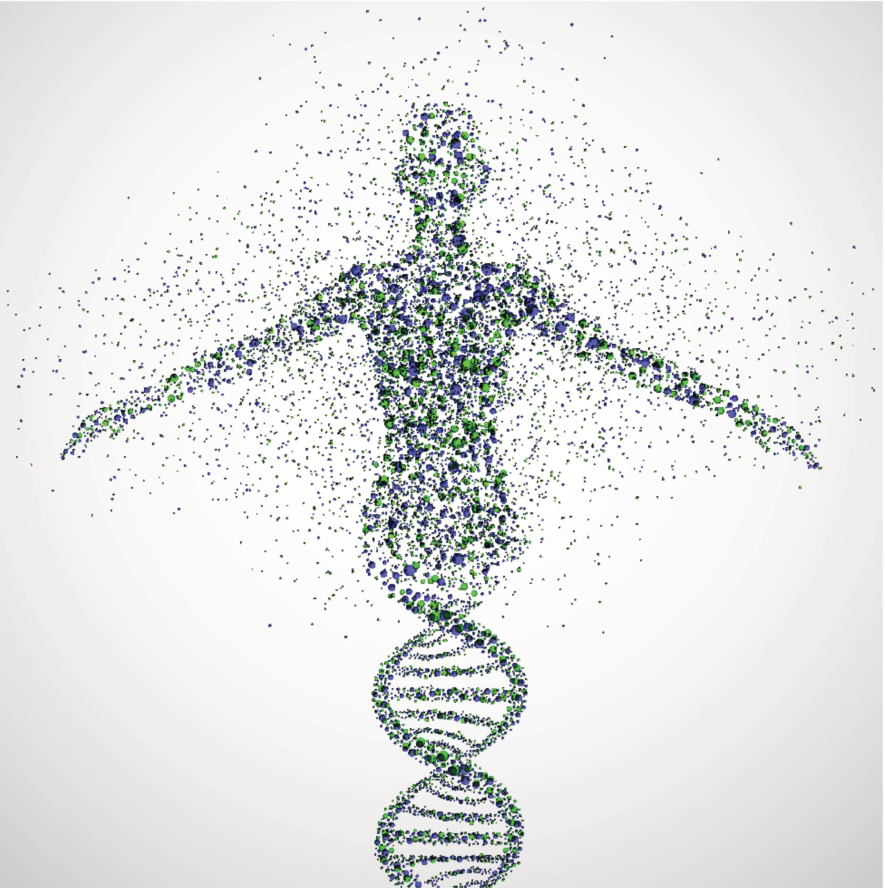
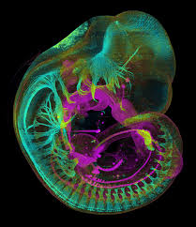
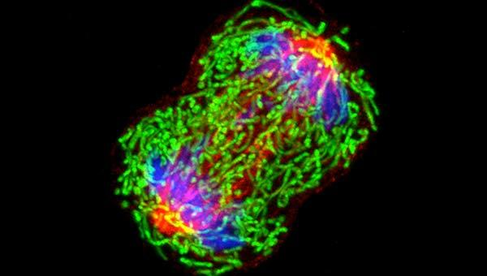
The Potential Role of Alternative Transcript Isoforms in Developmental Gene Expressions in Ants
Alternative Transcript Isoforms
∼90-95% of human genes with multiple exons generate alternative transcript isoforms
Disruptions of transcript generating mechanisms are hallmarks of many pathological conditions.
Embryonic Development
The relationship between alternative transcript generating mechanisms and physiological or pathological processes have been and are being extensively investigated.
Yoon, Yoseop, et al. “Embryo Polarity in Moth Flies and Mosquitoes Relies on Distinct Old Genes with Localized Transcript Isoforms.” ELife, vol. 8, Aug. 2019,
Https://www.cancer.gov/about-cancer/understanding/what-is-cancer
https://tbdo.crg.eu/industry-and-investors/licensing/images/mouse-embryo-neurofilament-and-e-cadherin-staining
https://geneticliteracyproject.org/2018/06/01/humans-may-have-more-genes-than-we-thought-and-why-it-matters/
Notes:
Humans and other mammals in general have between 20-30k genes. On a numerical scale, that is not very different than protists or worms such as C.elegans. However, recent advancements in bioinformatics and highthroughput sequencing studies have revealed that over 90% of…
These processes can generate cell or tissue specific alternative gene products and are part of normal development and physiology. Conversely, fisruptions of ATI generating mechanisms can lead to many pathological conditions such as muscular dystrophy and it is known that some malignant tumors can have cell-specific ATI.
My Project is a step towards a more comprehensive understanding of the potential roles alternative transcript isoforms play in the evolution of novel embryonic developmental processes.
Disruptions of transcript generating mechanisms and variations in the transcriptomes are the hallmark of many pathological processes such as cancer.
https://geneticliteracyproject.org/2018/06/01/humans-may-have-more-genes-than-we-thought-and-why-it-matters/
Https://www.cancer.gov/about-cancer/understanding/what-is-cancer
u3d / Shutterstock.com

Slide 4
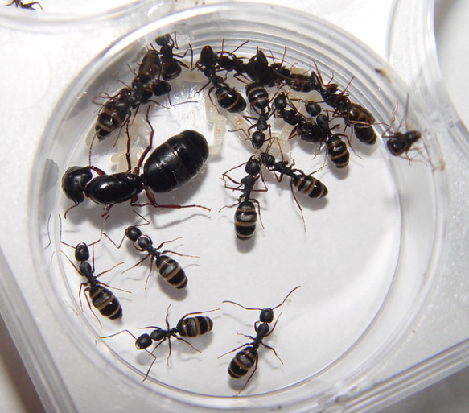
Carpenter Ants
The Potential Role of Alternative Transcript Isoforms in Developmental Gene Expressions in Ants
Easy experimental manipulation
Easy acquisition of a high number of genetically similar embryos
Novel gene expressions make them ideal experimental subjects
Rafiqi, A.M., Rajakumar, A. & Abouheif, E. Origin and elaboration of a major evolutionary transition in individuality. Nature 585, 239–244 (2020).
https://www.flickr.com/photos/29847562@N00/2339611360/in/photostream/
Notes:
For this purpose, I used carpenter ants as a model organism. The reason these ants were chosen is because it… On a more specific note, carpenter ants have an intracellular integrated bacterial endosymbiont. And the developmental integration is mediated by the expression of two particular Hox genes, which is the focus of this research.
Easy experimental manipulation
Easy acquisition of high number of genetically similar embryos

Slide 5
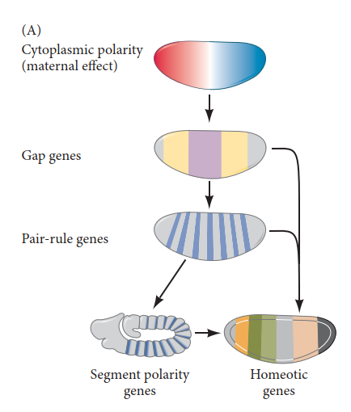
The Potential Role of Alternative Transcript Isoforms in Developmental Gene Expressions in Ants
Maternal Effect, Hox Genes and
Development
Early development is controlled by maternally provided proteins and mRNAs.
Hox genes are expressed in late development and are highly conserved.
The canonical role of Hox genes is to specify the bodyplan.
Maternal Effect Genes
Zygotic Genes
Rafiqi, A.M., Rajakumar, A. & Abouheif, E. Origin and elaboration of a major evolutionary transition in individuality. Nature 585, 239–244 (2020).
Gilbert, Scott F. 2000. Developmental biology. Sunderland, Mass: Sinauer Associates.
Notes:
In most animals, the early developmental processes are controlled and the developmental genetic cascade is initiated by transcription factors that come from the mother, hence called maternal genes. The zygotic gene expression soon takes over and the other steps of this cascade are zygotically expressed, including Hox genes which are later expressed. These genes are known to be highly conserved across all animals and their canonical role is to specify the bodyplan.

Slide 6
The Potential Role of Alternative Transcript Isoforms in Developmental Gene Expressions in Ants
Two Hox Genes have recently evolved non-Canonical Expression with Novel Function in a group of Ants
Maternal Effect Genes
Stage-1 Embryo
Ultrabithorax (Ubx) & abdominal-A (abd-A)
Novel Expression
Novel
Zygotic Genes
Stage-12 Embryo
Ultrabithorax (Ubx) & abdominal-A (abd-A)
Conserved Expression
Conserved
Rafiqi, A.M., Rajakumar, A. & Abouheif, E. Origin and elaboration of a major evolutionary transition in individuality. Nature 585, 239–244 (2020).
Gilbert, Scott F. 2000. Developmental biology. Sunderland, Mass: Sinauer Associates.
Notes:
In carpenter ants, two hox genes, Ultrabithorax and abdominal-A have acquired new expression patterns and functions in addition to their conserved, pre-existing expressions and roles. The conserved expression is seen the one on the bottom, the blue is DNA stain and the purplish colored areas are the joint expressions of these two genes.
The novel maternal expression can be seen here. The red is the DNA stain and the green areas are the joint expressions of the two genes of interest.

Slide 7
The Potential Role of Alternative Transcript Isoforms in Developmental Gene Expressions in Ants
Hypothesis: The transcripts of Ubx and abdA genes in different stages differ from each other
Maternal Effect Genes
Novel
Stage-1 Embryo
Ubx & abdA
Novel Expression
Zygotic Genes
Stage-12 Embryo
Ubx & abdA
Conserved Expression
Conserved
Rafiqi, A.M., Rajakumar, A. & Abouheif, E. Origin and elaboration of a major evolutionary transition in individuality. Nature 585, 239–244 (2020).
Gilbert, Scott F. 2000. Developmental biology. Sunderland, Mass: Sinauer Associates.
Notes:
Our hypothesis is that the transcripts of the two developmental stage-specific expressions of these two Hox genes are different.

Slide 8
Aim
Hypothesis: The transcripts of Ubx and abdA genes in different stages differ from each other
The aim of this study was to determine whether alternative transcript dependent mechanisms have played any role in the evolution of novel gene expressions and functions of Ubx and abdA.
https://en.wikipedia.org/wiki/Protein_isoform#/media/File:DNA_alternative_splicing.gif

Slide 9
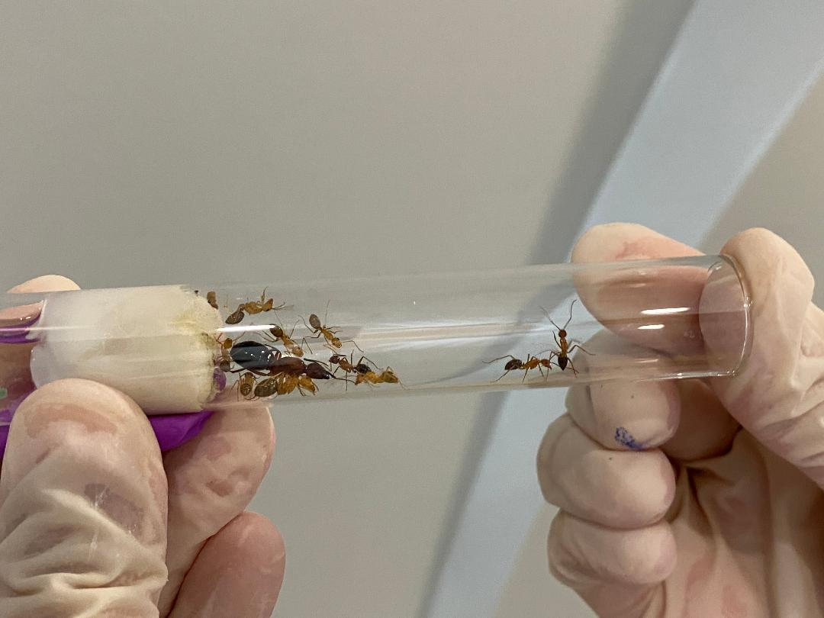
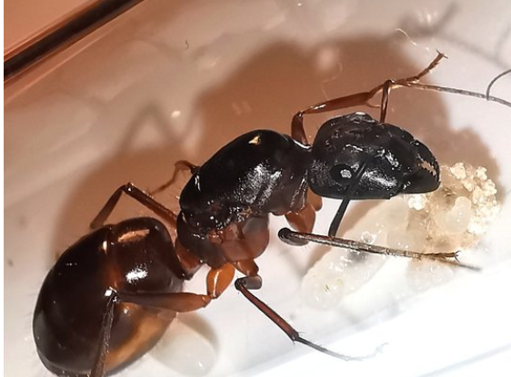
Materials and Methods
Hypothesis: The transcripts of Ubx and abdA genes in different stages differ from each other
N=15, stage1, Ubx
(1)
N=15, stage1, abdA
(2)
N=15, stage12, Ubx
Camponotus floridanus queens were isolated from colonies.
The freshly laid eggs were collected and allowed to develop until the appropriate stage.
Total RNA isolation
N=15, stage12, abdA
Chomczynski, P. 1993. A reagent for the single-step simultaneous isolation of RNA, DNA and proteins from cell and tissue samples. BioTechniques 15, 532-537
https://emea.support.illumina.com/bulletins/2019/10/best-practices-to-minimize-rrna-contamination-in-truseq-stranded.html
Notes:
Now how did we tackle this?
We seperated the queens of Camponotus ant colonies and collected the queen’s embryos everyday for a period of two weeks...The collected embryos were homogenized in TRI-reagent and phenol-chloroform RNA extraction was done. cDNA was synthesized from reverse transcriptase. After the cDNAs were obtained, RACE were conducted to get the transcripts. The obtained transcripts were sequenced and aligned to their counterpart from different development stages and to a reference sequence available at NCBI.

Slide 10
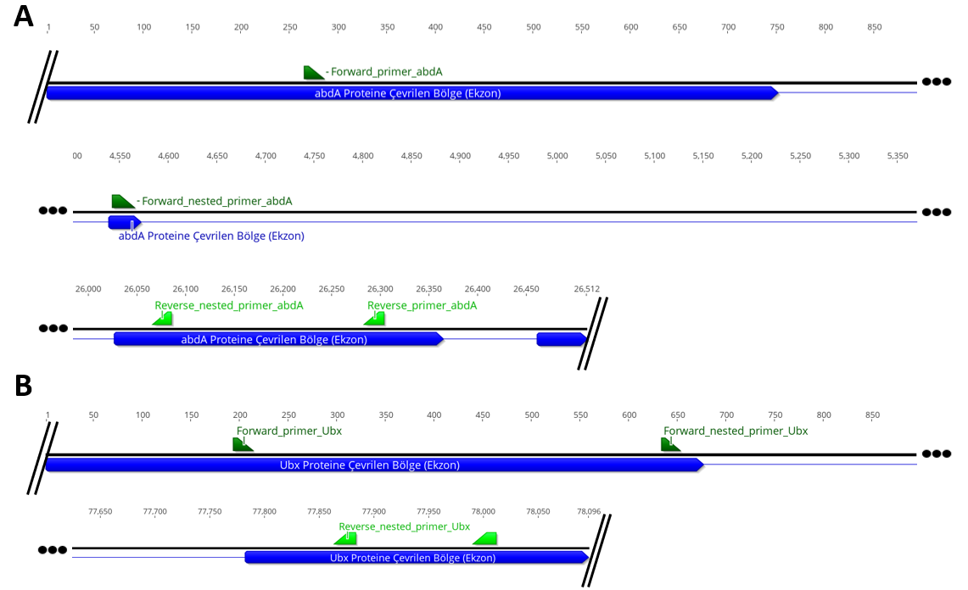
Hypothesis: The transcripts of Ubx and abdA genes in different stages differ from each other
(4)
abdA
(3)
Ubx
cDNA synthesis
Rapid Amplification of cDNA Ends
Bertling, W. M., Beier, F. & Reichenberger, E. Determination of 5' ends of specific mRNAs by DNA ligase-dependent amplification. PCR Methods Appl. 3, 95–9 (1993). Frohman, M. A. Rapid amplification of complementary DNA ends for generation of full-length complementary DNAs: thermal RACE. Methods Enzymol. 218, 340–56 (1993).
Notes:
After the cDNAs were obtained, RACE were conducted to get the transcripts.

Slide 11
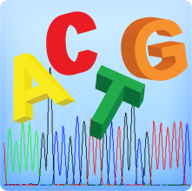
Hypothesis: The transcripts of Ubx and abdA genes in different stages differ from each other
(7)
(5)
(6)
Alignment of sequenced DNA fragments to each other and to a reference sequence from NCBI
DNA fragments
from PCR
Sanger DNA Sequencing
The experiments were centered around PCR reactions and Sanger Sequencing, therefore, the results are sequence results.
Conventional statistical analyses were not conducted due to the results being DNA sequences and the nature of the PCR-centered experimental design.
https://www.mclab.com/DNA-Sequencing-Services.html
https://www.pngitem.com/middle/hbwwxTT_dna-red-and-blue-transparent-cartoons-dna-red/
Notes:
The obtained transcripts were sequenced and aligned to their counterpart from different development stages and to a reference sequence available at NCBI.

Slide 12
Results: abdA
Hypothesis: The transcripts of Ubx and abdA genes in different stages differ from each other
SIMILARITY (%) | NCBI Reference Sequence | abdA Stage 1 | abdA Stage 12
NCBI Reference Sequence | - | 96.06% | 92.82%
abdA Stage 1 | 96.06% | - | 93.59%
abdA Stage 12 | 92.82% | 93.59% | -
Notes:
Here, we see the alignment of the developmental stage specific expressions of abdA.
And I know this looks a bit confusing to most of you, so I would actually like you to focus here on the identity up here. The green highligghted areas are where the consensus??? is the same. The red interruptions are where we know that there are some differences.
The sequence is for the mostpart same, with some minör differences at the ends of the sequences. These differences however are not meaningful in terms of alternative transcript isoforms, they are probably errors from Sanger sequencing.
The similarity was about 93% for the two sequences.

Slide 13
Results: Ubx
Hypothesis: The transcripts of Ubx and abdA genes in different stages differ from each other
SIMILARITY (%) | NCBI Reference Sequence | abdA Stage 1 | abdA Stage 12
NCBI Reference Sequence | - | 94.42% | 87.66%
Ubx Stage 1 | 94.42% | - | 86.92%
Ubx Stage 12 | 87.66% | 86.92% | -
Notes:
We see a similar result with Ubx. We observe some minör differences at the two ends with most of the sequences being the same. These differences also probably arose from Sanger seq errors.
The similarity was 87% with Ubx.

Slide 14
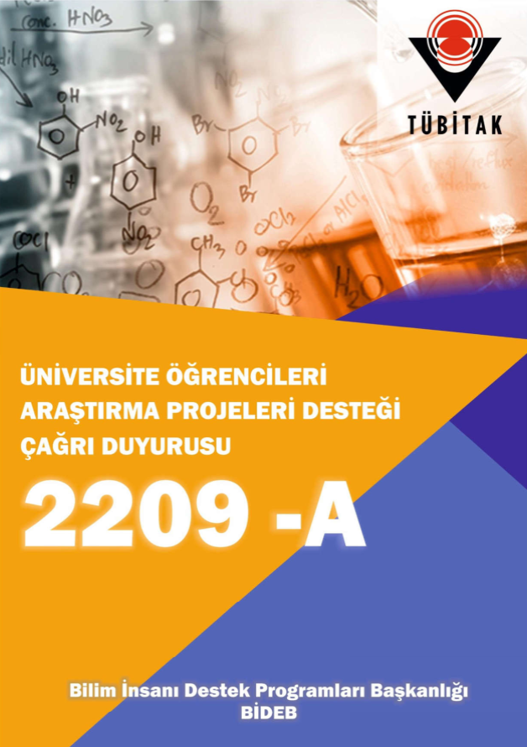
Conclusion and Future Directions
The Potential Role of Alternative Transcript Isoforms in Developmental Gene Expressions in Ants
In this study we discovered;
no significant differences between the protein coding regions of the developmental stage-specific expressions of Ubx and abdA.
The origin of the novel expressions are a result of changes in either the untranslated regions or the cis-regulatory sequences of these genes.
Stage-1 Embryo
Ubx & abdA
Novel Expression
Stage-12 Embryo
Ubx & abdA
Conserved Expression
Notes:
To conclude, we have not identified any significant differences between the translated regions of the developmental stage specific expressions of Ultrabithorax and abdominal-A. We think that the origin of the novel …
We had time and resource limitations including limitations on the number of experimental animals.
We will continue this...
we propose that differential expression of alternative transcript isoforms can result in the evolution of new gene functions, independent of, and prior to gene duplication and sub-functionalization. Given that alternative transcription is a widespread phenomenon, it could play an important role in the evolution of gene regulatory networks.
This is the second study that tried to address the involvement of the differential expression of alternative transcript isoforms in the evolution new gene functions and maternal expressions.

Slide 15
Acknowledgements
Ab. Matteen Rafiqi
Nihan Sultan Milat
Yoseop Yoon

Slide 16
Thank you for listening
Correspondence koraykasan@yahoo.com

